Slide 1

Enhancing digital literacy among senior citizens
Team 4 : Mindsparks
Bridging the "generational tech gap"

Slide 2

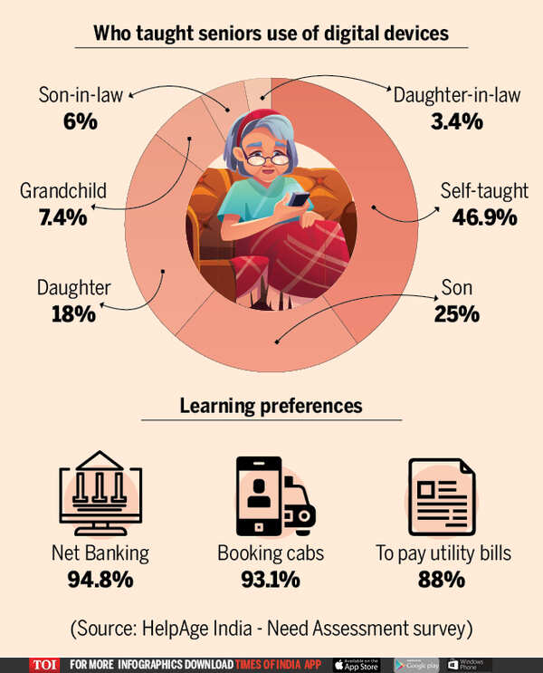
Introduction
In the modern digital era, many essential services such as banking, healthcare, communication, transportation, and government services are increasingly delivered through digital platforms.
Senior citizens often struggle to adapt to digital technologies due to limited digital literacy.
Digital literacy refers to the ability to access, understand, evaluate, and effectively use digital tools and online information.
Tasks such as online banking, digital payments, accessing healthcare appointments, or communicating through messaging platforms may seem complicated and intimidating.
Senior citizens may face difficulties accessing essential services, staying connected with family members, or managing personal financial transactions.

Slide 3

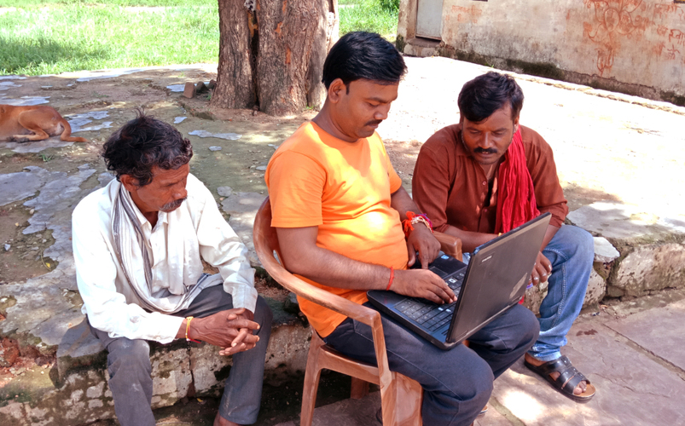
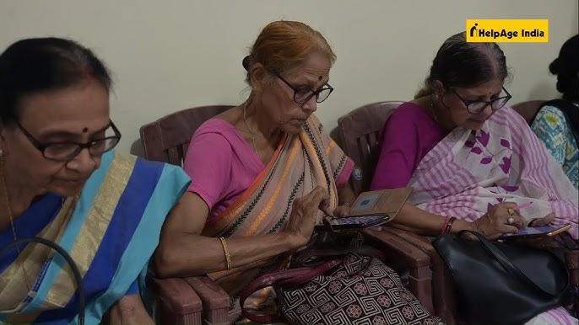
Why the Problem is Complex
1. Multiple Stakeholders
The issue involves several groups with different roles and interests, including:
Senior citizens
Family members and caregivers
Technology developers
Government agencies
Community organizations
Financial institutions
Each group has different perspectives and priorities, making it challenging to design a single solution that meets everyone’s needs.

Slide 4
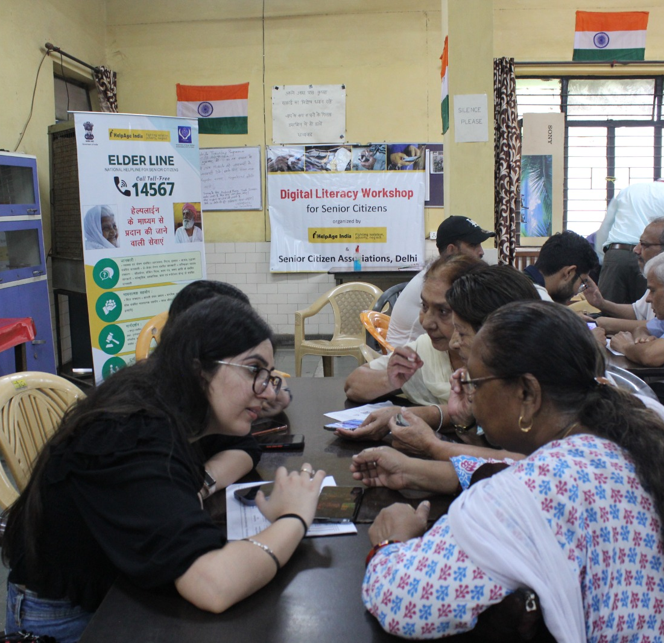
2. Diversity Among Senior Citizens
Senior citizens differ in terms of:
Education level
Economic status
Technology exposure
Health conditions
Some elderly individuals may have prior experience using computers, while others may have never interacted with digital technologies.

Slide 5
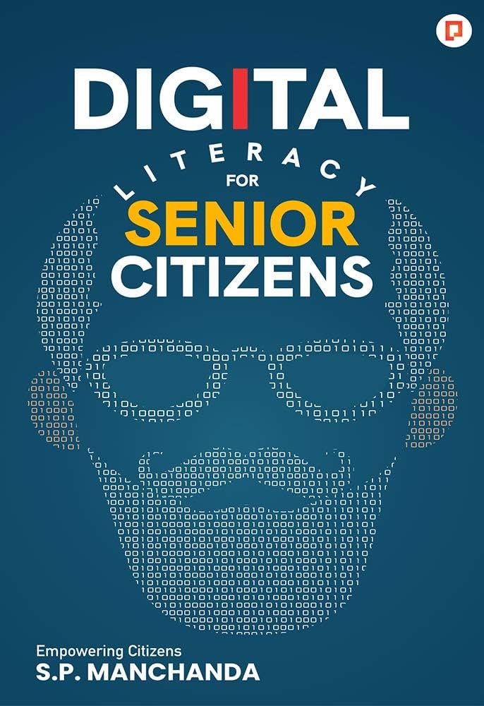
3. Rapid Technological Change
Digital technologies evolve quickly. Software updates, new applications, and changing interfaces can make it difficult for elderly individuals to keep up with technological developments.
4. Physical and Cognitive Limitations
Age-related issues such as poor eyesight, reduced motor skills, and memory challenges can make it difficult for senior citizens to use digital devices.
5. Psychological Barriers
Many elderly individuals feel anxious or fearful when using digital devices due to concerns about making mistakes or becoming victims of online fraud.
6. Accessibility and Infrastructure Issues
Limited internet connectivity, lack of digital devices, and insufficient training opportunities can further restrict digital learning among elderly populations.

Slide 6
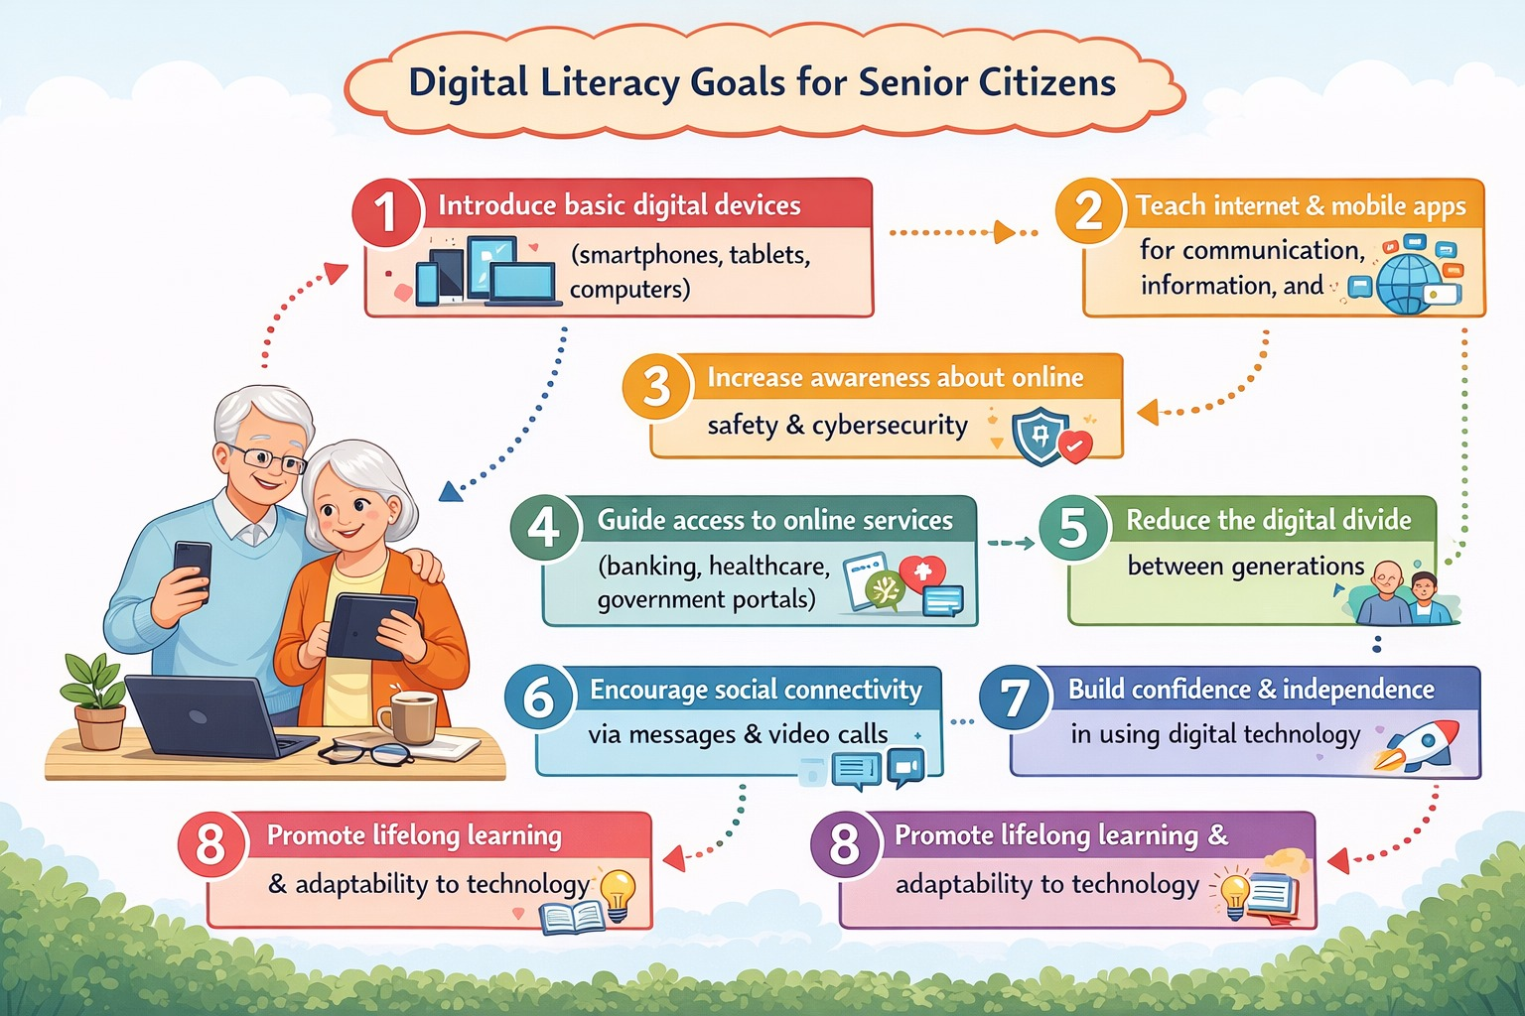
OBJECTIVES

Slide 7
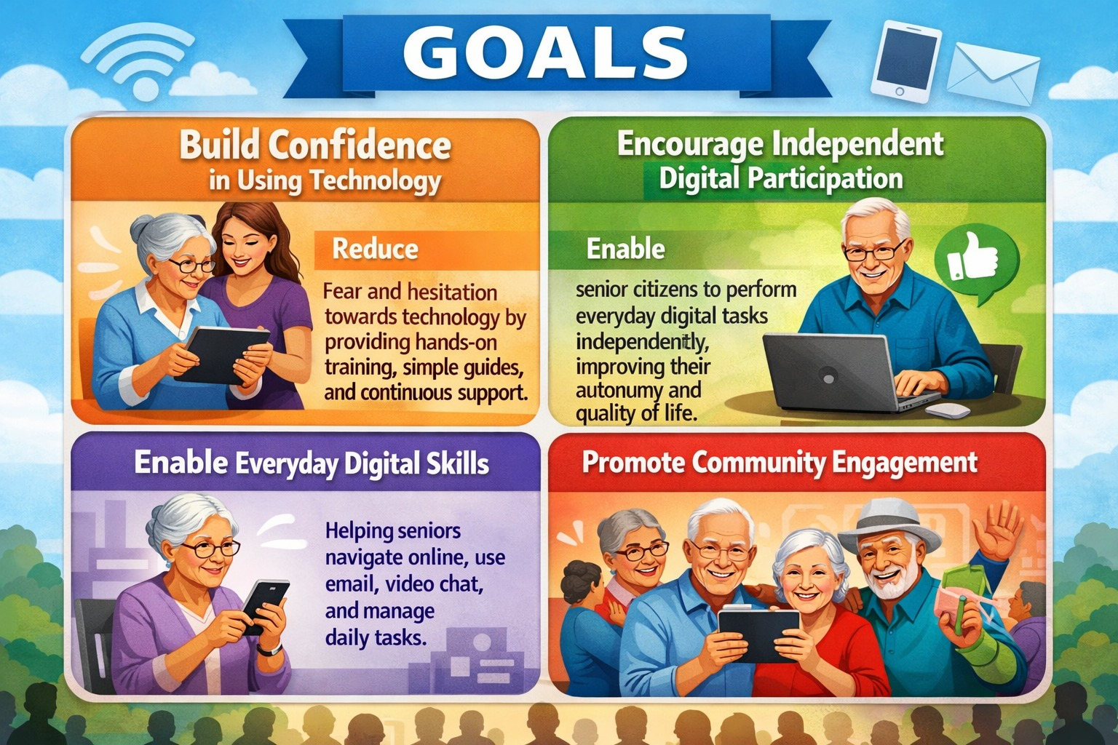

Slide 8
Project Planning - Table 1
Phase | Sub-Stages | Activities
1. Scope | • Identify project topic • Determine target group • Define scope and limitations • Identify expected outcomes • Plan timeline and resources | • Select the project topic related to digital literacy • Identify senior citizens as the target audience • Decide project boundaries and objectives • Estimate required resources such as devices and trainers • Prepare a project timeline
2. Empathize | • Interact with senior citizens • Conduct surveys or interviews • Identify challenges in using digital devices • Observe behavior and learning difficulties • Record user insights | • Visit communities or homes of senior citizens • Ask questions about their experience with smartphones or computers • Observe how they use digital devices • Collect feedback and document user needs

Slide 9
3. Define | • Analyze collected information • Identify key problems • Define the problem statement • Identify user needs • Finalize objectives | • Study survey responses and interview data • List the major difficulties faced by seniors • Write a clear problem statement • Confirm the objectives of the project
4. Ideate | • Brainstorm solutions • Explore different teaching methods • Generate learning ideas • Evaluate possible solutions • Select the best approach | • Conduct brainstorming sessions with team members • Suggest ideas like workshops, tutorials, and simple guides • Discuss interactive teaching methods • Select the best digital literacy training model

Slide 10
5. Prototype | • Design training materials • Create learning modules • Prepare step-by-step guides • Develop sample workshops • Test prototype content | • Create presentations and printed guides • Develop simple tutorials for smartphone use • Design step-by-step instructions for apps and internet browsing • Prepare sample training sessions
6. Validation | • Conduct pilot training sessions • Observe user interaction • Collect participant feedback • Identify problems in training • Improve the model | • Organize a trial training session for a small group of seniors • Observe how they follow the instructions • Ask participants for suggestions and feedback • Identify unclear steps or difficulties • Modify the training materials accordingly

Slide 11
7. Implementation | • Conduct full training program • Provide hands-on practice • Teach communication apps and online safety • Provide continuous guidance • Monitor participant progress | • Organize digital literacy workshops • Teach seniors how to use smartphones and internet • Demonstrate messaging, video calling, and online payments • Guide participants individually when needed • Track improvement in their digital skills
8. Report | • Document project process • Record findings and results • Analyze project effectiveness • Provide recommendations • Prepare final report | • Compile all project activities and data • Summarize observations and outcomes • Evaluate how the project improved digital literacy • Suggest improvements for future programs • Submit the final capstone project report

Slide 12

Project Requirements
A. Functional Requirements
User Profiles: Ability for seniors to create simplified profiles with large-scale avatars and basic contact info.
Modular Learning Path: A structured curriculum including:
Basics: Turning on devices, Wi-Fi connectivity, and gesture control (tap, swipe).
Voice-Guided Navigation: An integrated AI voice assistant to guide users through the interface.
Interactive Exercises: "Sandbox" modes where users can practice sending a text or "paying" a mock bill without real-world consequences.
Progress Tracking: Visual milestones (badges or stars) to provide positive reinforcement and a sense of accomplishment.
Essential Services: Online banking basics, booking medical appointments, and using government portals.
Cybersecurity: Modules on identifying phishing, creating strong passwords, and "red-flag" recognition for scams.

Slide 13
B. Non-Functional Requirements
Usability (Accessibility): Must comply with WCAG 2.1 Level AA standards.
Reliability: The system should have 99.9% uptime, as seniors may lose confidence if the tool is frequently unavailable.
Security: Multi-factor authentication (MFA) that uses simple methods like biometric (fingerprint) or physical security keys rather than complex SMS codes.
Patience-First Design: The system should not "time out" quickly; extended session times are required for slower input speeds.

Slide 14
Technical Specifications
User Interface (UI) Specifications
Feature | Specification
Typography | Minimum 18pt font size; Sans-serif fonts (e.g., Arial, Roboto) for better legibility.
Color Contrast | Minimum contrast ratio of 4.5:1 for text and interactive elements.
Touch Targets | Buttons must be at least 48x48 dp to accommodate reduced manual dexterity.
Visual Cues | Avoid "hamburger menus"; use clearly labeled icons with text underneath (e.g., an icon of a house with the word "Home").

Slide 15
Solution Model / Outcome
The proposed solution is to conduct digital literacy training programs specifically designed for senior citizens. The training will include simple lessons on using smartphones, browsing the internet, sending messages, making video calls, and performing online transactions safely.
Expected outcomes include:
Senior citizens gaining confidence in using digital devices.
Increased ability to communicate with family and friends through digital platforms.
Better awareness about cybersecurity and online scams.
Greater independence in performing online tasks such as paying bills or accessing services.

Slide 16
Phase wise Planning
Stage | Tools | Outcome | Metrics / Rubrics
Scope | Project proposal, planning documents, timeline charts | Clear understanding of project goals, scope, and target group | Defined objectives, approved project plan, clear timeline
Empathize | Surveys, interviews, observation sheets, questionnaires | Understanding the needs, challenges, and experiences of senior citizens with digital technology | Number of surveys conducted, quality of user insights, identification of key user needs
Define | Data analysis tools, notes, problem statement templates | Clear problem statement and defined project objectives | Well-defined problem statement, list of major challenges identified

Slide 17
Ideate | Brainstorming sessions, mind maps, discussion boards | Generation of innovative ideas and possible solutions for digital literacy training | Number of ideas generated, feasibility of selected solution
 | Conversational AI Learning Assistants - ChatGPT | Seniors can use it to: Learn how to use smartphones Write emails or messages Get step-by-step instructions for digital tasks. It works like a personal digital tutor that responds to natural conversation.

Slide 18
Ideate | AI Voice Assistants for Hands-Free Learning
 | Amazon Alexa | Voice-controlled assistant that helps seniors perform tasks such as: Setting reminders Making video calls Asking questions and learning new information. Voice interaction makes technology easier for seniors who struggle with typing or reading small screens.

Slide 19
Ideate | Perplexity AI | AI research assistant that searches the internet and summarizes information. Helpful for seniors learning how to find reliable online information.
 | AI Companion Tools for Learning and Engagement - Replika | AI chatbot designed for conversation and companionship. Helps seniors practice digital communication skills and become comfortable interacting with AI systems.

Slide 20
Prototype | Training materials, presentations, user guides, demonstration videos | Development of sample digital literacy training modules | Quality and usability of training materials, readiness of prototype session
Validation | Pilot workshops, feedback forms, observation checklists | Evaluation of prototype effectiveness through participant feedback | Participant satisfaction, clarity of training content, number of improvements identified

Slide 21
Implementation | Smartphones, computers, internet connection, training sessions | Successful delivery of digital literacy program to senior citizens | Number of participants trained, improvement in digital skills, engagement level
Report | Documentation tools, report templates, presentation software | Final project report summarizing process, results, and recommendations | Completeness of report, clarity of findings, quality of conclusions and recommendations
 | AI Tools for Learning Content Creation These tools help educators create simple training materials for seniors. Canva (Magic Write) | AI feature that generates: presentations infographics visual guides. Useful for creating step-by-step visual instructions

Slide 22
Timeline
Week | Phase | Activities | Expected Outcome
Week 1 | Project Introduction | Introduce capstone objectives, form student groups, finalize project topic, assign roles | Finalized project title and team responsibilities
Week 2 | Literature Review | Review research papers, reports on digital literacy, understand digital divide among seniors | Literature review summary
Week 3 | Problem Identification | Identify common digital challenges faced by senior citizens, define target group | Initial problem statement
Week 4 | Empathy Stage – Survey Design | Prepare questionnaires and interview questions, plan survey methodology | Finalized survey tools

Slide 23
Week 5 | Empathy Stage – Data Collection | Conduct surveys and interviews with senior citizens, observe device usage | Raw data and interview insights
Week 6 | Data Analysis | Analyze responses, identify major digital literacy gaps | Needs assessment report
Week 7 | Define Stage | Develop clear problem statement and define project scope | Defined project objectives
Week 8 | Ideation Stage | Brainstorm innovative solutions and training methods | List of potential solutions
Week 9 | Solution Selection | Evaluate ideas based on feasibility and effectiveness | Selected digital literacy training model

Slide 24
Week 10 | Prototype Development | Develop training materials such as manuals, infographics, and guides | Prototype digital literacy toolkit
Week 11 | Pilot Testing | Conduct small-scale training session for few seniors | Initial feedback on training module
Week 12 | Refinement | Improve training materials based on feedback | Finalized training toolkit
Week 13 | Implementation | Conduct digital literacy workshops for senior citizens | Successful training sessions
Week 14 | Evaluation | Conduct post-training survey and assess skill improvement | Impact evaluation data

Slide 25
Week 15 | Documentation | Prepare final project report and analyze results | Draft report and data presentation
Week 16 | Final Presentation | Prepare presentation, posters, and submit final report | Project completion and evaluation

Slide 26
Rubrics for Evaluation
Criteria | Excellent (4) | Good (3) | Satisfactory (2) | Needs Improvement (1) | Marks
Problem Identification & Understanding | Clearly defines the problem with strong background research and clear objectives | Problem identified with some background research | Basic problem identification but limited clarity | Problem not clearly defined | /10
Empathy & Data Collection | Comprehensive surveys/interviews with proper analysis of user needs | Adequate data collected with some analysis | Limited data collected with minimal analysis | Poor or no user data collection | /10

Slide 27
Innovation & Creativity | Highly innovative solution with creative approach | Some innovative ideas presented | Basic solution with limited creativity | No innovation or originality | /10
Methodology & Implementation | Well-structured methodology with effective implementation | Methodology mostly clear with adequate implementation | Basic methodology with partial implementation | Poorly planned methodology | /10
Prototype / Training Material Development | High-quality prototype or learning materials that are practical and user-friendly | Good prototype with minor improvements needed | Basic prototype developed | Prototype incomplete or ineffective | /10

Slide 28
Impact & Outcome Evaluation | Clear evidence of impact with data analysis and feedback | Some evaluation of impact presented | Limited evaluation of outcomes | No impact assessment | /10
Teamwork & Collaboration | Excellent teamwork and clear role distribution | Good collaboration among members | Some teamwork but uneven participation | Poor teamwork | /10
Documentation & Report Writing | Well-organized report with proper references, figures, and formatting | Good report with minor errors | Basic report with limited structure | Poorly written or incomplete report | /10

Slide 29
Presentation & Communication | Clear, confident, and engaging presentation | Good presentation with minor issues | Basic presentation with limited clarity | Poor presentation skills | /10
Overall Project Quality & Relevance | Project highly relevant and demonstrates strong learning outcomes | Relevant project with good outcomes | Moderate relevance and learning | Limited relevance or outcomes | /10

Slide 30
Budget
Item | Purpose | Quantity (Example) | Estimated Cost per Unit (INR) | Total Cost (INR)
Tablets | For hands-on digital literacy training | 10 | ₹20,000/- | ₹2,00,000/-
Internet Data Plan (SIM / Wi-Fi) | Internet access for training sessions | 10 | ₹400 per month | ₹16000/-
Tablet Covers / Screen Guards | Protection for devices | 10 | ₹300 | ₹3000/-
Printing Training Materials | Manuals, guides, instructions | - | - | ₹1000/-
Posters / Infographics | Visual teaching aids | - | - | ₹1000/-
Stationery | Pens, markers, chart papers | - | - | ₹1000/-
Refreshments for Participants (optional) | Encourage participation | - | - | ₹1000/-
Miscellaneous Expenses | Unforeseen costs | - | - | ₹1000/-
 |  |  | Total Cost: | 2,24,000/-

Slide 31
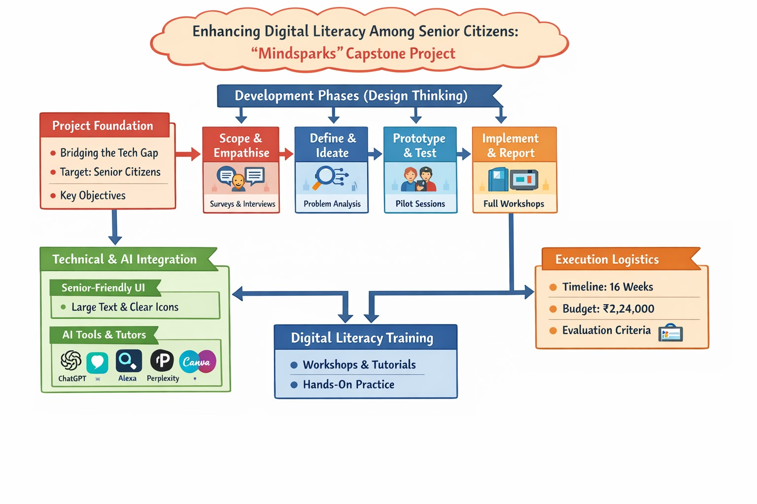
Mind Map

Slide 32
References
Oh, S. S., Kim, K.‑A., Kim, M., Oh, J., Chu, S. H., & Choi, J. (2021). Measurement of digital literacy among older adults: Systematic review. Journal of Medical Internet Research, 23(2), e26145. https://doi.org/10.2196/26145
Moore, R. C., & Hancock, J. T. (2022). A digital media literacy intervention for older adults improves resilience to fake news. Scientific Reports, 12, 6008. https://doi.org/10.1038/s41598‑022‑08437‑0
Jena, B., & Paltasingh, T. (2024). Digital literacy among older adults: A systematic review in the Indian context. Educational Gerontology, 51(4), 371–386. https://doi.org/10.1080/03601277.2024.2397428

Slide 33
Bhatia, R., & Khan, F. (2024). Digital literacy among elderly people and usage of digital means. International Journal of Research and Analysis in Commerce and Management, 3(6), 1–14.
Yang, X., Hu, W., & Deng, Y. (2025). Digital literacy impacts quality of life among older adults through hierarchical mediating mechanisms. Scientific Reports, 15, Article 19288. https://doi.org/10.1038/s41598‑025‑04472‑9
Shi, Z., Du, X., Li, J., Hou, R., Sun, J., & Marohabutr, T. (2024). Factors influencing digital health literacy among older adults: A scoping review. Frontiers in Public Health, 12, 1447747.

Slide 34
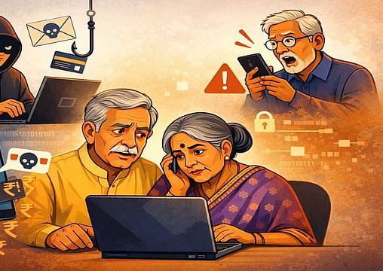
Thank you

